Slide 1
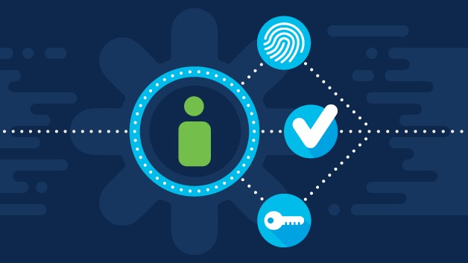
Identity & Access Management
in Microsoft Azure AD
By
Vinu Francis
Vinu.francisiam@gmail.com

Slide 2
01
Identity and Access Management (IAM) is a framework of policies and technologies to ensure that the right users have the appropriate access to the resources. IAM is a critical component of any organization’s digital security infrastructure.
What is Identity
and Access
Management
02
Enterprises need to manage access to information across internal and external application systems. Moreover, they must provide this access for a growing number of identities, both inside and outside the organization.

Slide 3
03
IAM comprises of people, processes and products to manage identities and access to resources of an enterprise. Additionally, the enterprise shall have to ensure the correctness of data across all the systems to avoid conflicts.
What is Identity
and Access
Management
04
IAM components can be classified into 4 major categories: authentication, authorization, user management and central user repository (Enterprise Directory). The ultimate goal of IAM Framework is to provide the right access to the right people at the right time.

Slide 4
IAM/IDAM
Identity
and Access
Management
Identity Management
Access Management

Slide 5
Authentication
Authorization
Single Sign-On
Session Management
Password Service
Strong Authentication
Role-based
Rule-based
Artribute-based
Remote - Authorization
Access
Management
Identity
Management
Identity and Access Management(IAM)
Providing the right people with
the right access at the right time.
User Management
User Repository
Delegated Administration
User and Role Management
Provisioning
Password Management
Self - service
Directory
Data Synchronization
Meta - directory
Virtual directory

Slide 6
01
Identity manager allows administrators to Create, Update Disable/Delete
User accounts across all the systems in your organization, all from a central point Access review Certification
What
Identity Manager
does?
02
It manages the complete life cycle of employee user accounts from hiring to termination

Slide 7
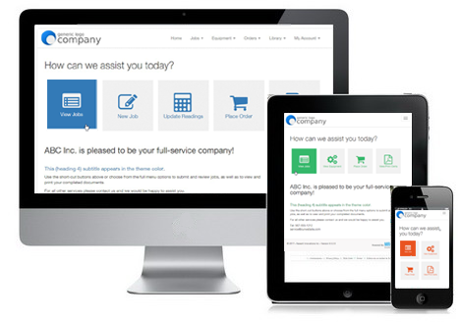
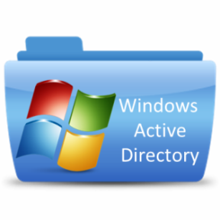





Self Service
Portal
User
Provisioning
Create user in Oracle HRMS
Name : Vimal
Employee ID : 2345
IDM in a Box

Slide 8





Identity Manager
Resource
IDM is Processing
The user account
From HRMS
Synchronize User
Resource
Resource
Identity Manager Application Server

Slide 9
01
Identity manager also provides features like
02
Self Service Password Reset
What
else..?
03
Profile Update for Phone/Address book
04
Without having to call the helpdesk, saving your time and money

Slide 10

Self Service
Portal
User
Provisioning
With Approval
Approval
Create user in Oracle HRMS
Name : Shyam
Employee ID : 4345
IDM in a Box

Slide 11
Access Management
Access
Management
Web
Enterprise SSO

Slide 12
01
Authentication
02
Authorization
Access
Management
03
Auditing
04
Administration

Slide 13
01
Allows you to login once with username and
password and you can access any Windows, Web
and Mainframe application without login again.
Enterprise Single
Sign (ESSO)

Slide 14
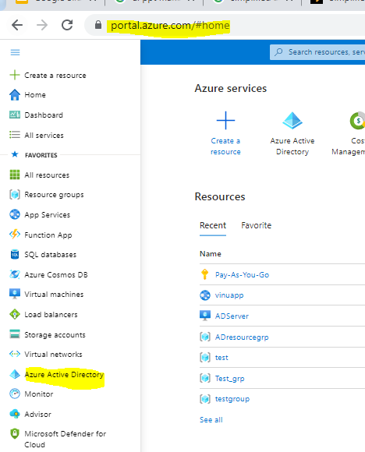
Azure Active Directory (Azure AD) is an enterprise identity service that provides single sign-on, multifactor authentication, and conditional access to guard against 99.9 percent of cyber security attacks.
Azure AD is one of the service available in Microsoft Azure cloud platform.
01
What is Azure AD?

Slide 15

How the identity
Is synced to
Azure AD
AD
Azure AD Connect
Azure AD
Once the account is provisioned by IDM in on-prem Active Directory the Azure AD connect will sync the account to Azure AD.

Slide 16

How the identity
Is synced to
Azure AD
?

Slide 17
How the identity
Is synced to
Azure AD
?

Slide 18
User is synced
to Azure AD

Slide 19
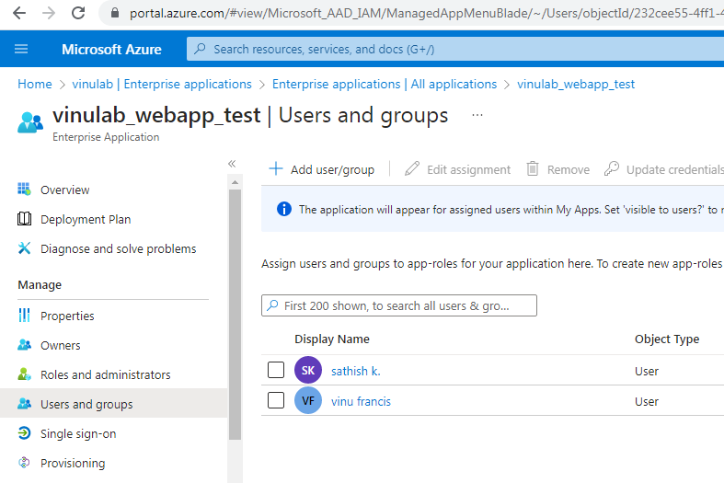
Application access is controlled by individual/group/role assignments
How access is
controlled in
Azure AD?

Slide 20
Access is
restricted without
assignment

Slide 21
User got access
through
direct
assignment

Slide 22
User got access
through
direct
assignment

Slide 23
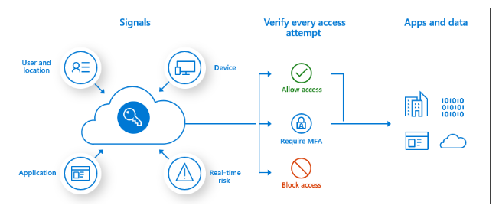
Conditional Access policies at their simplest are if-then statements,
if a user wants to access a resource, then they must complete an action.
Example: A payroll manager wants to access the payroll application and is
required to do multifactor authentication to access it.
Conditional
Access Policy

Slide 24
Conditional
Access Policy

Slide 25
Conditional
Access Policy

Slide 26
Single Sign-on

Slide 27
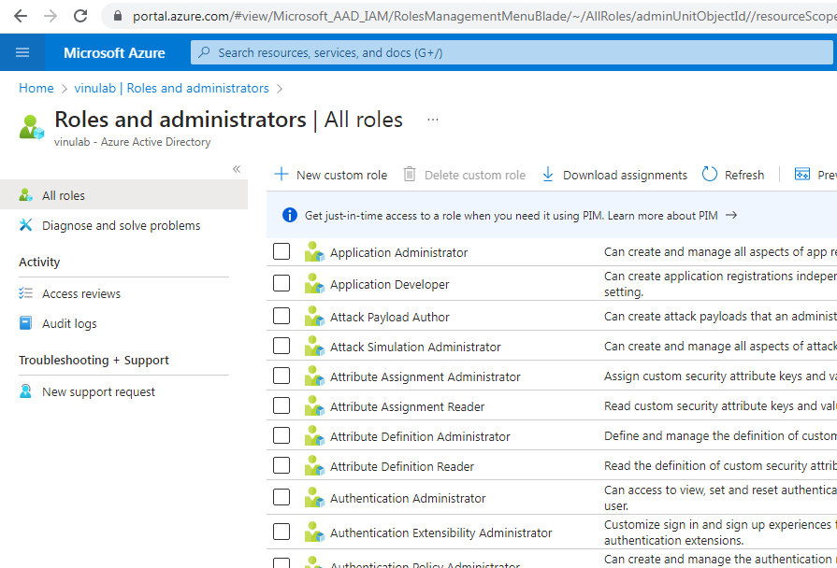
Administrative roles are used for granting access for privileged actions in Azure AD.
Roles
&
Administrators

Slide 28
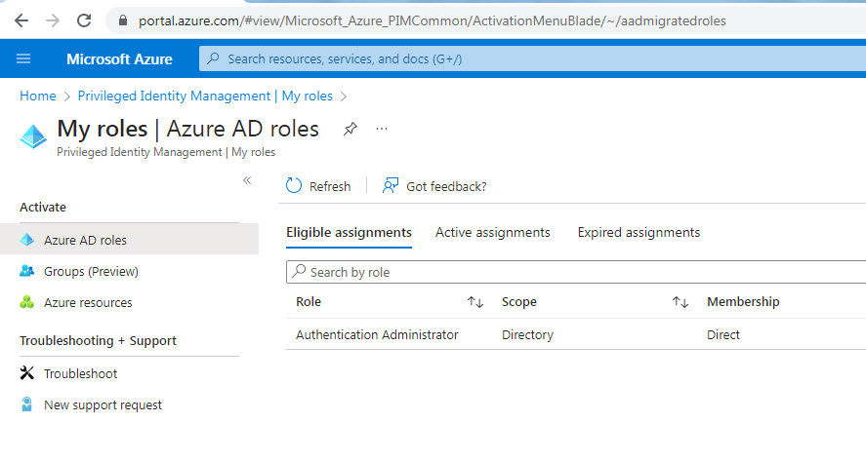
Enforces just in time access to perform the Admin activity
User has to activate the role to elevate to the role
Privileged
Identity
Management

Slide 29
External users life cycle management
Self service capability for access
Just in time/time bound access
Access review
Identity
Governance

Slide 30

Questions?

